Slide 1
Cryptography
Public key cryptography and RSA
Lecture 7
Notes:
Lecture slides by Lawrie Brown for “Cryptography and Network Security”, 5/e, by William Stallings, Chapter 9 – “Public Key Cryptography and RSA”.

Slide 2
Chapter 9 – Public Key Cryptography and RSA
Every Egyptian received two names, which were known respectively as the true name and the good name, or the great name and the little name; and while the good or little name was made public, the true or great name appears to have been carefully concealed.
—The Golden Bough, Sir James George Frazer
Notes:
Opening quote.

Slide 3
Private-Key Cryptography
traditional private/secret/single key cryptography uses one key
Key is shared by both sender and receiver
if the key is disclosed communications are compromised
also known as symmetric, both parties are equal
  hence does not protect sender from receiver forging a message & claiming is sent by sender
Notes:
So far all the cryptosystems discussed have been private/secret/single key (symmetric) systems. All classical, and modern block and stream ciphers are of this form.

Slide 4
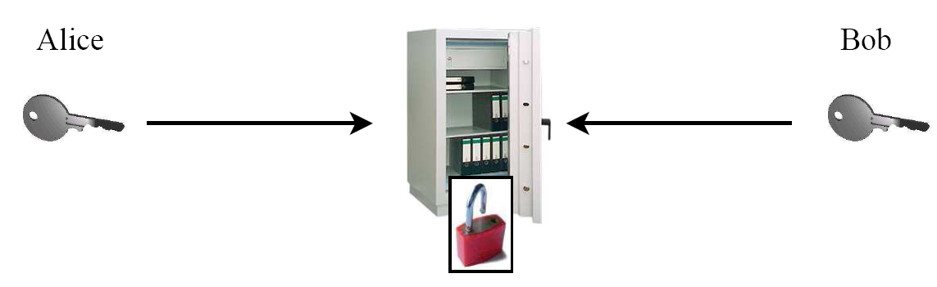
Symmetric Cryptography: Analogy
Safe with a strong lock, only Alice and Bob have a copy of the key
Alice encrypts → locks message in the safe with her key
Bob decrypts → uses his copy of the key to open the safe
K
K

Slide 5
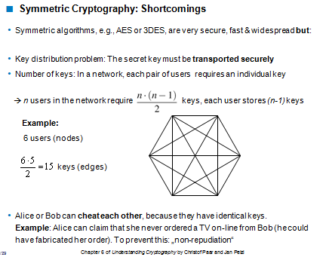

Slide 6
Public-Key Cryptography
probably most significant advance in the 3000 year history of cryptography
uses two keys – a public key and a private key
asymmetric since parties are not equal
uses clever application of number theory concepts to function
complements rather than replaces private key cryptography
Notes:
Will now discuss the radically different public key systems, in which two keys are used. Anyone knowing the public key can encrypt messages or verify signatures, but cannot decrypt messages or create signatures, counter-intuitive though this may seem. It works by the clever use of number theory problems that are easy one way but hard the other. Note that public key schemes are neither more secure than private key (security depends on the key size for both), nor do they replace private key schemes (they are too slow to do so), rather they complement them.

Slide 7


Idea behind Asymmetric Cryptography
New Idea:
Use the „good old mailbox“ principle:
Everyone can drop a letter
But: Only the owner has the
correct key to open the box
1976: first publication of such an algorithm by Whitfield Diffie and Martin Hellman,and also by Ralph Merkle.

Slide 8
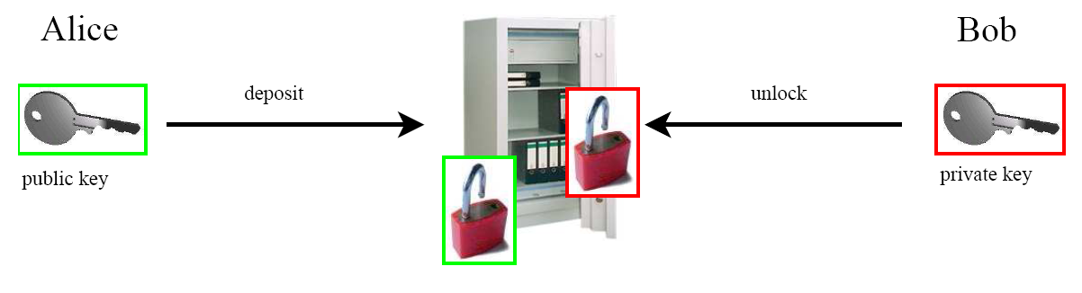
Asymmetric Cryptography: Analogy
Safe with public lock and private lock:
(K_{pub})
(K_{pr})
Alice deposits (encrypts) a message with the - not secret - public key K_{pub}
Only Bob has the - secret - private key K_{pr} to retrieve (decrypt) the message

Slide 9
Public-Key Cryptography
public-key/two-key/asymmetric cryptography involves the use of two keys:
  a public-key, which may be known by anybody, and can be used to encrypt messages, and verify signatures
  a private-key, known only to the recipient, used to decrypt messages, and sign (create) signatures
is asymmetric because
  those who encrypt messages or verify signatures cannot decrypt messages or create signatures

Slide 10
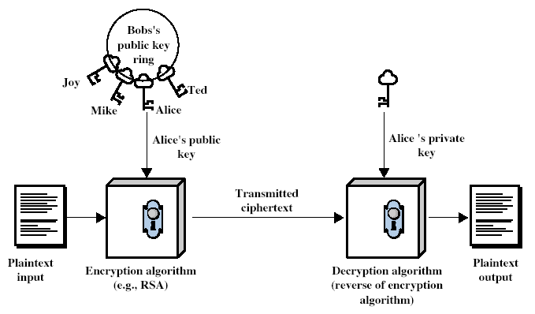
Public-Key Cryptography
Notes:
Stallings Fig 9-1.

Slide 11
Why Public-Key Cryptography?
developed to address two key issues:
  key distribution – how to have secure communications in general without having to trust a KDC with your key
  digital signatures – how to verify a message comes intact from the claimed sender
public invention due to Whitfield Diffie & Martin Hellman at Stanford U. in 1976
  known earlier in classified community
Notes:
The idea of public key schemes, and the first practical scheme, which was for key distribution only, was published in 1977 by Diffie & Hellman. The concept had been previously described in a classified report in 1970 by James Ellis (UK CESG) - and subsequently declassified in 1987. See History of Non-secret Encryption (at CESG). Its interesting to note that they discovered RSA first, then Diffie-Hellman, opposite to the order of public discovery!

Slide 12
Public-Key Characteristics
Public-Key algorithms rely on two keys with the characteristics that it is:
  computationally infeasible to find decryption key knowing only algorithm & encryption key
  computationally easy to en/decrypt messages when the relevant (en/decrypt) key is known
  either of the two related keys can be used for encryption, with the other used for decryption (in some schemes)
Notes:
Public key schemes utilise problems that are easy (P type) one way but hard (NP type) the other way, eg exponentiation vs logs, multiplication vs factoring. Consider the following analogy using padlocked boxes: traditional schemes involve the sender putting a message in a box and locking it, sending that to the receiver, and somehow securely also sending them the key to unlock the box. The radical advance in public key schemes was to turn this around, the receiver sends an unlocked box to the sender, who puts the message in the box and locks it (easy - and having locked it cannot get at the message), and sends the locked box to the receiver who can unlock it (also easy), having the key. An attacker would have to pick the lock on the box (hard).

Slide 13
A breakthrough idea
Rather than having a secret key that the two users must share, each users has two keys.
One key is secret and he is the only one who knows it
The other key is public and anyone who wishes to send him a message uses that key to encrypt the message
Diffie and Hellman first (publicly) introduced the idea in 1976 – this was radically different than all previous efforts

Slide 14
A word of warning
Public-key cryptography complements rather than replaces symmetric cryptography
There is nothing in principle to make public-key crypto more secure than symmetric crypto
Public-key crypto does not make symmetric crypto obsolete: it has its advantages but also its (major) drawbacks such as speed
Due to its low speed, it is mostly confined to key management and digital signatures

Slide 15
…
Some algorithms (such as RSA) satisfy also the following useful characteristic:
Either one of the two keys can be used for encryption – the other one should then be used to decrypt the message

Slide 16
Essential steps in public-key encryption
Each user generates a pair of keys to be used for encryption and decryption
Each user places one of the two keys in a public register and the other key is kept private
If B wants to send a confidential message to A, B encrypts the message using A’s public key

Slide 17
…
When A receives the message, she decrypts it using her private key
Nobody else can decrypt the message because that can only be done using A’s private key
Deducing a private key should be infeasible
If a user wishes to change his keys – generate another pair of keys and publish the public one: no interaction with other users is needed

Slide 18
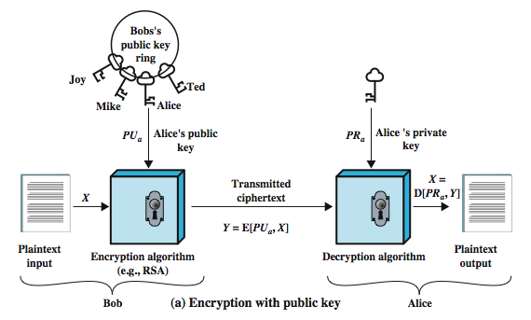
Bob sends an encrypted message to Alice

Slide 19
Some notation
The public key of user A will be denoted PU_{A}
The private key of user A will be denoted PR_{A}
Encryption method will be a function E
Decryption method will be a function D
If B wishes to send a plain message X to A, then he sends the cryptotext Y=E(PU_{A},X)
The intended receiver A will decrypt the message: D(PR_{A},Y)=X

Slide 20
A first attack on the public-key scheme – authenticity
Immediate attack on this scheme:
An attacker may impersonate user B: he sends a message E(PU_{A},X) and claims in the message to be B – A has no guarantee this is so
This was guaranteed in classical cryptosystems simply through knowing the key (only A and B are supposed to know the symmetric key)

Slide 21
The authenticity of user B can be established as follows:
B will encrypt the message using his private key: Y=E(PR_{B},X)
This shows the authenticity of the sender because (supposedly) he is the only one who knows the private key
The entire encrypted message serves as a digital signature

Slide 22
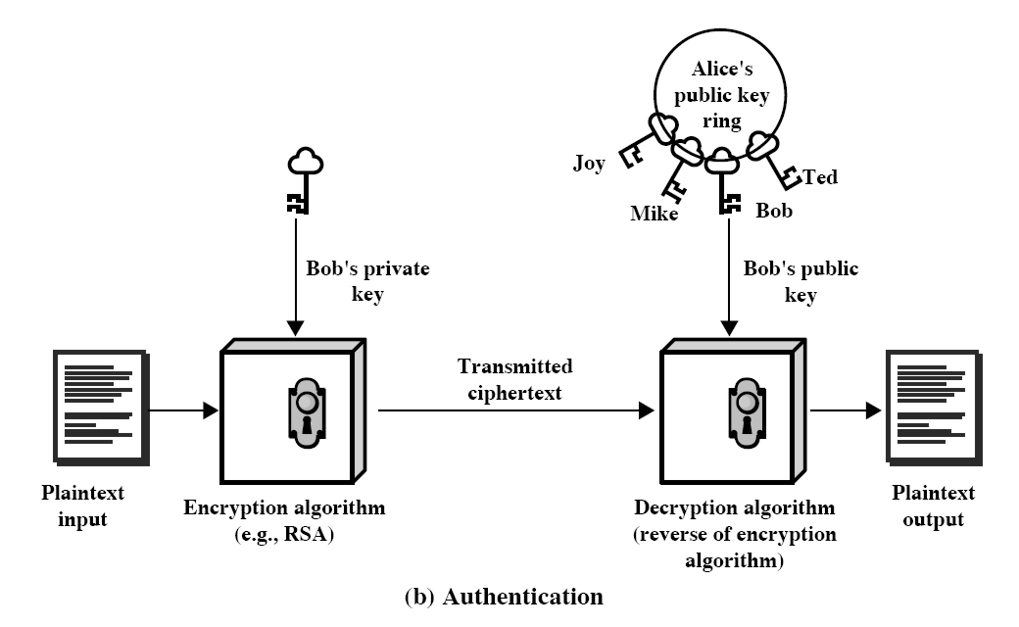
A scheme to authenticate the sender of the message

Slide 23
Encryption and authenticity
Still a drawback: the scheme on the previous slide authenticate but does not ensure security: anybody can decrypt the message using B’s public key

Slide 24
One can provide both authentication and confidentiality using the public-key scheme twice:
B encrypts X with his private key: Y=E(PR_{B},X)
B encrypts Y with A’s public key: Z=E(PU_{A},Y)
A will decrypt Z (and she is the only one capable of doing it): Y=D(PR_{A},Z)
A can now get the plaintext and ensure that it comes from B (he is the only one who knows his private key): decrypt Y using B’s public key: X=E(PU_{B},Y)

Slide 25
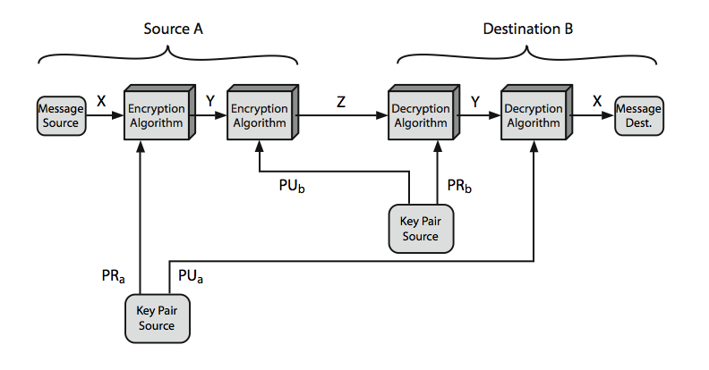
Secrecy and authentication using public-key schemes.

Slide 26
Applications for public-key cryptosystems
Encryption/decryption: sender encrypts the message with the receiver’s public key
Digital signature: sender “signs” the message (or a representative part of the message) using his private key
Key exchange: two sides cooperate to exchange a secret key for later use in a secret-key cryptosystem

Slide 27
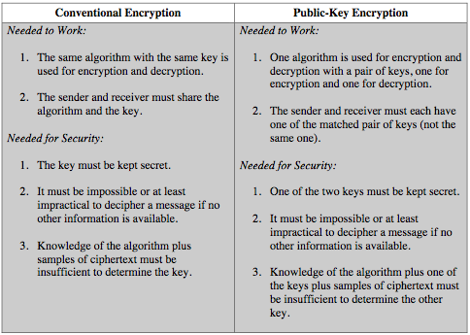
Symmetric vs Public-Key
Notes:
Stallings Table 9.2 summarizes some of the important aspects of symmetric and public-key encryption. To discriminate between the two, we refer to the key used in symmetric encryption as a secret key. The two keys used for asymmetric encryption are referred to as the public key and the private key. Invariably, the private key is kept secret, but it is referred to as a private key rather than a secret key to avoid confusion with symmetric encryption.

Slide 28
Security of Public Key Schemes
like private key schemes brute force exhaustive search attack is always theoretically possible
but keys used are too large (>512bits)
security relies on a large enough difference in difficulty between easy (en/decrypt) and hard (cryptanalyse) problems
more generally the hard problem is known, its just made too hard to do in practise
requires the use of very large numbers
hence is slow compared to private key schemes
Notes:
Public key schemes are no more or less secure than private key schemes - in both cases the size of the key determines the security. Note also that you can't compare key sizes - a 64-bit private key scheme has very roughly similar security to a 512-bit RSA - both could be broken given sufficient resources. But with public key schemes at least there's usually a firmer theoretical basis for determining the security since its based on well-known and well studied number theory problems.

Slide 29
RSA
by Rivest, Shamir & Adleman of MIT in 1977
best known & widely used public-key scheme
based on exponentiation in a finite (Galois) field over integers modulo a prime
uses large integers eg. 1024 bits.(309 decimal digits)
security due to cost of factoring large numbers
Notes:
RSA is the best known, and by far the most widely used general public key encryption algorithm, and was first published by Rivest, Shamir & Adleman of MIT in 1978 [RIVE78]. The Rivest-Shamir-Adleman (RSA) scheme has since that time reigned supreme as the most widely accepted and implemented general-purpose approach to public-key encryption. It is based on exponentiation in a finite (Galois) field over integers modulo a prime, using large integers (eg. 1024 bits). Its security is due to the cost of factoring large numbers.

Slide 30
Encryption and Decryption
RSA operations are done over the integer ring Z_{n} (i.e., arithmetic modulo n), where n = p * q, with p, q being large primes
Encryption and decryption are simply exponentiations in the ring
In practice x, y, n and d are very long integer numbers (≥ 1024 bits)
The security of the scheme relies on the fact that it is hard to derive the „private exponent“ d given the public-key (n, e)
Definition
Given the public key (n,e) = k_{pub} and the private key d = k_{pr} we write
y = e_{kpub}(x) ≡ x^{e} mod n
x = d_{kpr}(y) ≡ y^{d} mod n
where x, y ε Z_{n.}
We call e_{kpub}() the encryption and d_{kpr}() the decryption operation.

Slide 31
Key Generation
Like all asymmetric schemes, RSA has set-up phase during which the private and public keys are computed
Remarks:
Choosing two large, distinct primes p, q (in Step 1) is non-trivial
gcd(e, Φ(n)) = 1 ensures that e has an inverse and, thus, that there is always a private key d
Algorithm: RSA Key Generation
Output: public key: k_{pub} = (n, e) and private key k_{pr} = d
Choose two large primes p, q
Compute n = p * q
Compute Φ(n) = (p-1) * (q-1)
Select the public exponent e ε {1, 2, …, Φ(n)-1} such that
gcd(e, Φ(n) ) = 1
Compute the private key d such that d * e ≡ 1 mod Φ(n)
RETURN k_{pub} = (n, e), k_{pr} = d

Slide 32
Example: RSA with small numbers
ALICE
Message x = 4
y = x^{e} ≡ 4³ ≡ 31 mod 33
BOB
Choose p = 3 and q = 11
Compute n = p * q = 33
Φ(n) = (3-1) * (11-1) = 20
Choose e = 3
d ≡ e⁻¹ ≡7 mod 20
y^{d} = 31⁷ ≡ 4 = x mod 33
K_{pub} = (33,3)
y = 31

Slide 33
Using the Euclidean algorithm
If we need to find d = e⁻¹ mod n and we can find integers x and y such that
ex + ny = 1
then the inverse d is the value of x.
find d = 3⁻¹ mod 20, we first obtain
gcd(20, 3) and check that it's 1 (otherwise the inverse doesn't exist)
    20 = 3 x 6 + 2
    3 = 2 x 1 + 1
giving gcd(20, 3) = 1

Slide 34
nx + ey = 1,
1 = 3 - 1 x 2
    = 3 - 1 x (20 - 6 x 3)
    = -1 x 20 + 7 x 3
The value of x (the coefficient of 3) is 7, so the inverse is 7.

Slide 35
RSA example:
Bob chooses p=5, q=7. Then n=35, z=24.
e=5 (so e, ø(n) relatively prime).
d=29 (so ed-1 exactly divisible by ø(n) or
d * e ≡ 1 mod Φ(n).
m
e
e
letter
m
c = m mod n
encrypt:
l
12
1524832
17
d
d
c
c
m = c mod n
letter
decrypt:
17
481968572106750915091411825223071697
12
l

Slide 36
RSA Security
possible approaches to attacking RSA are:
  brute force key search - infeasible given size of numbers
  mathematical attacks - based on difficulty of computing ø(n) , by factoring modulus n
  timing attacks - on running of decryption
  chosen ciphertext attacks - given properties of RSA
Notes:
Note some possible possible approaches to attacking the RSA algorithm, as shown.
The defense against the brute-force approach is the same for RSA as for other cryptosystems, namely, use a large key space. Thus the larger the number of bits in d, the better. However because the calculations involved both in key generation and in encryption/decryption are complex, the larger the size of the key, the slower the system will run.
Will now review the other possible types of attacks.

Slide 37
Timing Attacks
developed by Paul Kocher in mid-1990’s
exploit timing variations in operations
  eg. multiplying by small vs large number
  or IF's varying which instructions executed
infer operand size based on time taken
RSA exploits time taken in exponentiation
countermeasures
  use constant exponentiation time
  add random delays
  blind values used in calculations
Notes:
Have a radical new category of attacks developed by Paul Kocher in mid-1990’s, based on observing how long it takes to compute the cryptographic operations. Timing attacks are applicable not just to RSA, but to other public-key cryptography systems. This attack is alarming for two reasons: It comes from a completely unexpected direction and it is a ciphertext-only attack. A timing attack is somewhat analogous to a burglar guessing the combination of a safe by observing how long it takes for someone to turn the dial from number to number.
Although the timing attack is a serious threat, there are simple countermeasures that can be used, including using constant exponentiation time algorithms, adding random delays, or using blind values in calculations.

Slide 38
Chosen Ciphertext Attacks
RSA is vulnerable to a Chosen Ciphertext Attack (CCA)
attackers chooses ciphertexts & gets decrypted plaintext back
choose ciphertext to exploit properties of RSA to provide info to help cryptanalysis
can counter with random pad of plaintext
or use Optimal Asymmetric Encryption Padding (OASP)
Notes:
The RSA algorithm is vulnerable to a chosen ciphertext attack (CCA). CCA is defined as an attack in which adversary chooses a number of ciphertexts and is then given the corresponding plaintexts, decrypted with the target’s private key. The adversary exploits properties of RSA and selects blocks of data that, when processed using the target’s private key, yield information needed for cryptanalysis. Can counter simple attacks with random pad of plaintext. More sophisticated variants need to modify the plaintext using a procedure known as optimal asymmetric encryption padding (OAEP).

Slide 39
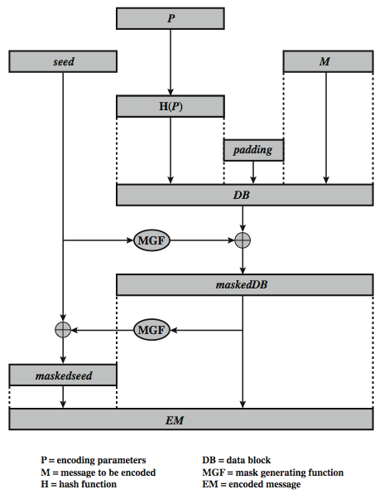
Optimal Asymmetric Encryption Padding (OASP)
Notes:
To counter such attacks RSA Security Inc., a leading RSA vendor and former holder of the RSA patent, recommends modifying the plaintext using a procedure known as optimal asymmetric encryption padding (OAEP). Stallings Figure 9.10 depicts OAEP encryption. As a first step the message M to be encrypted is padded. A set of optional parameters P is passed through a hash function H. The output is then padded with zeros to get the desired length in the overall data block (DB). Next, a random seed is generated and passed through another hash function, called the mask generating function (MGF). The resulting hash value is bit-by-bit XORed with DB to produce a maskedDB. The maskedDB is in turn passed through the MGF to form a hash that is XORed with the seed to produce the masked seed. The concatenation of the maskedseed and the maskedDB forms the encoded message EM. Note that the EM includes the padded message, masked by the seed, and the seed, masked by the maskedDB. The EM is then encrypted using RSA.

Slide 40
Summary
have considered:
  principles of public-key cryptography
  RSA algorithm, implementation, security
Notes:
Chapter 9 summary.

Slide 41
References and further readings
Book: cryptography and network security by William Stalling 5th edition chapter 9
Book:Understanding cryptography by christof Paar chapter 6 & 7

